Slide 1
Learner-Directed Learning: Canvas LMS
By: Dr. Mathias Fonkam (Dean SITC & Associate Prof SITC@AUN)

Slide 2
Outline of Presentation
Why Learner-directed Learning
Key Drivers of LDL
On Course (Re-) Design Supporting LDL*
  Learning Theories & Implications
The Emerging Future: Online Learning!
Technology Support: Canvas LMS + Course Design Template*
How We Assess LDL Teaching & Learning
Conclusions

Slide 3
Why Learner Directed Learning (LDL)
Research shows as most effective, cheapest & empowering!
Online is future of learning...the future university is online!
Life-long learning as broad goal for all today
  Only sustainable competitive advantage is rate of learning.. P. Senge
For Nigeria & SSA, huge opportunity to close the knowledge, economic, wealth etc gaps..
  But how? Online opens up and levels playing field in education & learning .. Lots of freely available multi-media learning resources online!
More equitable world? No one needs it more than us!
  "Knowledge is freedom" - Nelson Mandela

Slide 4
Key Drivers of LDL
IT & Computing.. especially web, cloud & mobile (their support for e-resources!!)
Growing content on web..(educational)
Efforts to grow economies & empowerment
Globalization and opportunities else where
  Uneven distribution of resources, opportunities & wealth
Growing influence of social media & collabs!

Slide 5
Course Design 2 Support LDL: Theories
Goal of instruction➔ promote learning (understanding).
Fundamental principle: course design determines effectiveness & hence quality.
According to AAHE, good teaching & learning practice:
  Encourages contacts between students and faculty.
  Develops reciprocity and cooperation among students.
  Uses active learning techniques.
  Gives prompt feedback.
  Emphasizes time on task.
  Communicates high expectations.
  Respects diverse talents and ways of learning Add to this:
  motivate learners
  facilitate deep processing
  contextual learning
  provide support during the learning process.

Slide 6
Course Design 4 LDL: Theory - Behaviorist
Looks at overt behaviors that can be observed and measured as indicators of learning, not internal thought processes in the mind.
Some Implications on Learning:
  Learners should be told the explicit outcomes of the learning so that they can set expectations and can judge for themselves whether or not they have achieved them
  Learners must be tested against learning outcomes..
  Learning materials must be sequenced appropriately to promote learning.
  Learners must be provided with feedback so corrective action if required.

Slide 7
Course Design 4 LDL: Theory - Cognitivist
Cognitivists see learning as an internal process that involves memory, thinking, reflection, abstraction, motivation, and meta-cognition.
Cognitive psychology looks at learning from an information processing model of the human mind:
Notes:
Cognitivists see learning as an internal process that involves memory, thinking, reflection, abstraction, motivation, and meta-cognition. Cognitive psychology looks at learning from an information processing point of view, where the learner uses different types of memory during learning. Sensations are received through the senses into the sensory store before processing occurs. The information persists in the sensory store for less than one second (Kalat, 2002); if it is not transferred to working memory immediately, it is lost.
Instruction strategy must allow learners to attend to the learning materials so that they can be transferred from the senses to the sensory store and then to working memory. The amount of information transferred to working memory depends on the amount of attention that was paid to the incoming information, and on whether cognitive structures are in place to make sense of the information. So, course designers must check to see if the appropriate existing cognitive structure is present to enable the learner to process the information. If the relevant cognitive structure is not present, pre-instructional strategies, such as advance organizers, should be included as part of the learning process (Ausubel, 1960).
The duration in working memory is approximately 20 seconds, and if information in working memory is not processed efficiently, it is not transferred to long-term memory for storage (Kalat, 2002). Online learning strategies must present the materials and use strategies to enable students to process the materials efficiently. Since working memory has limited capacity, information should be
organized or chunked in pieces of appropriate size to facilitate processing. According to Miller (1956), because humans have limited short-term memory capacity, information should be grouped into meaningful sequences. He suggests that information should be chunked into five to nine (i.e., 7 ± 2) meaningful units to compensate for the limited capacity of short-term memory.

Slide 8
Course Design 4 LDL: Theory - Cognitivist
Implications for teaching & learning
  Strategies should be used to allow learners to perceive and attend to the information so that it can be transferred to working memory.
  Strategies should be used to allow learners to retrieve existing information from long-term memory & link with new information.
  Information should be chunked to prevent overload during processing in working memory.
  To facilitate deep processing, learners should be asked to generate the information maps during the learning process or as a summary activity after the lesson
  Strategies that require learners to apply, analyze, synthesize, and evaluate promote higher-level learning, which makes the transfer to long term memory more effective – problem-centeredness helps!
Notes:
Implications for Online Learning
Strategies should be used to allow learners to perceive and attend to the information so that it can be transferred to working memory.
Important information should be placed in the center of the screen for reading, and learners must be able to read from left to right.
Information critical for learning should be highlighted to focus learners’ attention. For example, in an online lesson, headings should be used to organize the details, and formatted to allow learners to attend to and process the information they contain.
Learners should be told why they should take the lesson, so that they can attend to the information throughout the lesson.
The difficulty level of the material must match the cognitive level of the learner, so that the learner can both attend to and relate to the material. Links to both simpler and more complicated materials can be used to accommodate learners at different knowledge levels.
Strategies should be used to allow learners to retrieve existing information from long-term memory to help make sense of the new information.
Use advance organizers to activate an existing cognitive structure or to provide the information to incorporate the details of the lesson : comparative advance organizer can be used to recall prior knowledge to help in processing, and an expository advance organizer can be used to help incorporate the details of the lesson
Provide conceptual models that learners can use to retrieve existing mental models or to store the structure they will need to use to learn the details of the lesson.
Use pre-instructional questions to set expectations and to activate the learners’ existing knowledge structure. Questions presented before the lesson facilitate the recall of existing knowledge, and so help learners learn the materials and motivate them to find additional resources to achieve the lesson outcome.
Use prerequisite test questions to activate the prerequisite knowledge structure required for learning the new materials. With the flexibility of online learning, students with diverse
backgrounds and knowledge can choose the most appropriate path to review previous or prerequisite learning before new information is presented.
Information should be chunked to prevent overload during processing in working memory. To facilitate deep processing, learners should be asked to generate the information maps during the learning process or as a summary activity after the lesson (Bonk & Reynolds, 1997). In addition to facilitating deep processing, information maps can provide the “big picture” to learners, to help them comprehend the details of a lesson. Online learning can capitalize on the processing and visual capabilities of the computer to present information maps to learners or to ask learners to generate information maps using mapmaking software.
Other strategies that promote deep processing should be used to help transfer information to long-term storage. Strategies that require learners to apply, analyze, synthesize, and evaluate promote higher-level learning, which makes the transfer to long term memory more effective.

Slide 9
Course Design 4 LDL: Theory - Cognitivist
Individual differences – considers differences in learning styles (concrete vs reflective) & cognitive styles (abstract vs experimental).
  relate to perceiving and processing of information for long-term memory respectively.
Implications for learning
  Activities to support different styles of learning and cognitions (info processing)
  Present information in different modes – textual, verbal and visual to facilitate differences in processing and transfer to long-term memory
  Provide motivation for learning considering both intrinsic and extrinsic.
    Motivation should consider attention, relevance and confidence (design for success by going from simple to complex and known to unknown)
  Promote meta-cognitive skills .. Metacognition is a learner’s ability to be aware of his or her cognitive capabilities and use these capabilities to learn
Notes:
Cognitivist School of Thought: Part 1 – Individual Differences
Include a variety of learning strategies in online instruction to accommodate those differences. Learning style refers
to how a learner perceives, interacts with, and responds to the learning environment; it is a measure of individual differences Kolb (1984) suggests that two components make up our learning experience: perceiving and processing. Perceiving refers to the way learners sense and absorb the information around them, from concrete experience to reflective observation. Concrete experience relates to students’ desire to learn things that have personal meaning in life. With reflective observation, students like to take the time to think about and reflect on the learning materials. The second component, processing, is related to how learners understand and process the information that is absorbed after perceiving. Processing ranges from abstract conceptualization to active experimentation. Learners who have a preference for abstract conceptualization like to learn facts and figures, and to research new information on different topics. Learners who have a preference for active experimentation prefer to apply what they learn to real-life situations and to go beyond what was presented. They like to try things and learn from their experience. Online learning can cater for individual differences by determining the learner’s preference and providing appropriate learning activities based on the learner’s style. Cognitive style refers to a learner’s preferred way of processing information; that is, the person’s typical mode of thinking, remembering, or problem solving. Thus, cognitive style is another individual difference indicator. Cognitive style is considered to be a personality dimension that influences attitudes, values, and social interaction. One of the dimensions of cognitive style that has implications for online learning is the distinction between field dependent and field-independent personalities.
Implications for Online Learning Continued
Activities to support different learning styles from concrete-experience learners through reflective-observation learners and abstract conceptualization learners to active experimentation learners
Active support for different learning styles
Present information in different modes – textual, verbal and visual to facilitate differences in processing and transfer to long-term memory
Provide motivation for learning considering both intrinsic and extrinsic. Motivation should consider attention, relevance and confidence (design for success by going simple to complex and known to unknown
Promote meta-cognitive skills .. Metacognition is a learner’s ability to be aware of his or her
cognitive capabilities and use these capabilities to learn. When learning online, learners should be given the opportunity to reflect on what they are learning, collaborate with other learners, and to check their progress. Self-check questions and exercises with feedback throughout a lesson are good strategies to allow learners to check how they are doing, so that they can use their metacognitive skills to adjust their learning approach if necessary.
Online strategies that facilitate the transfer of learning should be used to encourage application in different and real-life situations. Simulation of the real situation, using real-life cases, should be part of the lesson. Also, learners should be given the opportunity to complete assignments and projects that use real life applications and information. Transfer to real-life situations could assist the learners to develop personal meaning and contextualize the information. Cognitive psychology suggests that learners receive and process information to be transferred into long-term memory for storage. The amount of information processed depends on the amount that is perceived, and the amount stored in long-term memory depends on the quality of the processing in working memory. Effective online lessons must use techniques to allow learners to sense and perceive the information, and must include strategies to facilitate high-level processing for transfer of information to long-term memory. After learners acquire the information, they create personal knowledge to make the materials meaningful. The constructivist school of learning, which is discussed below, suggests that learners construct personal knowledge from the learning experience.

Slide 10
Course Design 4 LDL: Theory - Constructivists
See learners as active rather than passive. Knowledge? is not received from the outside or from someone else; rather, it is the individual learner’s interpretation and processing of what is received through the senses that creates personal knowledge (understanding!).
  The learner is the center of the learning, with the instructor playing an advising and facilitating role (what the whole LDL is about!).
Implications for learning
  Learning should be an active process. Keeping learners active doing meaningful activities results in high-level processing, which facilitates the creation of personalized meaning.
  Provide active support for different learning styles
  Collaborative and cooperative learning should be encouraged to facilitate constructivist learning
  Learners should be given control of the learning process.
  Learners should be given time and opportunity to reflect
  Learning should be made meaningful for learners (contextualized!).
  Learning should be nteractive to promote higher-level learning and social presence, and to help develop personal meaning.
Notes:
Constructivist School of Learning
Constructivists see learners as being active rather than passive. Knowledge is not received from the outside or from someone else; rather, it is the individual learner’s interpretation and processing of what is received through the senses that creates knowledge. The learner is the center of the learning, with the instructor playing an advising and facilitating role. Learners should be allowed to construct knowledge rather than being given knowledge through instruction (Duffy & Cunningham, 1996). A major emphasis of constructivists is situated learning, which sees learning as contextual. Learning activities that allow learners to contextualize the information should be used in online instruction. If the information has to be applied in many contexts, then learning strategies that promote multi-contextual learning should be used to make sure that learners can indeed apply the information broadly. Learning is moving away from one-way instruction to construction and discovery of knowledge
Implications for Online Learning
Learning should be an active process. Keeping learners active doing meaningful activities results in high-level processing, which facilitates the creation of personalized meaning. Asking to apply the information in a practical situation is an active process, and facilitates personal interpretation and relevance.
Learners should construct their own knowledge rather than accepting that given by the instructor. Knowledge construction is facilitated by good interactive online instruction, since the students have to take the initiative to learn and to interact with other students and the instructor, and because the learning agenda is controlled by the student
Collaborative and cooperative learning should be encouraged to facilitate constructivist learning (Hooper & Hannafin, 1991; Johnson & Johnson, 1996; Palloff & Pratt, 1999). Working with other learners gives learners real-life experience of working in a group, and allows them to use their metacognitive skills. Learners will also be able to use the strengths of other learners, and to learn from others. When assigning learners for group work, membership should be based on the expertise level and learning style of individual group members, so that individual team members can benefit from one another’s strengths.
Learners should be given control of the learning process. There should be a form of guided discovery where learners are allowed to make decision on learning goals, but with some guidance from the instructor.
Learners should be given time and opportunity to reflect. When learning online, students need the time to reflect and internalize the information. Embedded questions on the content can be used throughout the lesson to encourage learners to reflect on and process the information in a relevant and meaningful manner; or learners can be asked to generate a learning journal during the learning process to encourage reflection and processing.
Learning should be made meaningful for learners. The learning materials should include examples that relate to students, so that they can make sense of the information. Assignments and projects should allow learners to choose meaningful activities to help them apply and personalize the information.
Learning should be interactive to promote higher-level learning and social presence, and to help develop personal meaning. According to Heinich et al. (2002), learning is the development of new knowledge, skills, and attitudes as the learner interacts with information and the environment

Slide 11
Course Design 4 LDL: The 3 Theories
Behaviorists’ strategies can be used to teach the “what” (facts),
cognitive strategies can be used to teach the “how” (processes and principles), and
constructivist strategies can be used to teach the “why” (higher level thinking that promotes personal meaning and situated and contextual learning).
A taxonomy of learning emerges combining all 3!

Slide 12
The Emerging Future: Online Learning (OL)
NUC reluctant yet!....but OL is the future!!
Consider status, trends, advantages & disadvantages
Consider MIT Open-Course-ware, MOOCs, Khan Academy, TED talks, YouTube, LinkedIn, Quora, SoloLearns on mobiles etc, etc
Evolve our own model for online courses taps into wealth of resources online (UFMA Virtual Univ!!)

Slide 13
Tech Support: Canvas LMS & Our Strategy
Learning Outcomes-driven course syllabus
PDF design template centered on activities & due dates
  Course broken into named logical modules
  Modules broken into scheduled activities due dates, graded or not
  Activities can include short video-clip, short lecture, in-class activity, short quiz, group or team exercise, home assignment etc
  Scheduled activities can be graded or not, have due-dates or not
System automatically manages the opening & closing of activities with due-dates including notifications and as part of student calendars
System supports student-student and student-faculty interactions through threaded discussions, announcements, ability to automate team assignments, online grading & notifications & email integration
Peer reviews possible – can add member as teacher, observer or student

Slide 14
Interactions with Canvas
Live Demo
Screen-shots (at end!)

Slide 15
How We Assess LDL on Canvas:Template
Course Presence
  Is the course present on Canvas with students added and signed up, home-page & Bios?
Course Syllabus
  Is there a syllabus for the course with: Learning Outcomes, Outline of Content, Approach to pedagogy & assessment, List of resources for course, class policy?
Course Content & Organization
  Is the content organized into modules with activities for each unit and explicit due dates that will trigger alerts to students and faculty?
  Are there lectures, texts and other resources posted for the course​?​​
Continuous Assessment
Level of Engagement & Interactions: student-student, student-instructor, etc
Question/Problem-Banks linked to Learning Outcomes?
Notes:
Course Presence
Is the course present on Canvas with students added and signed up?
Is the course published?
Is there a course home-page?
Has faculty published their Bio and asked students to publish their profiles?
Course Syllabus
Is there a syllabus for the course with: Learning Outcomes, Outline of Content, List of resources, Approach to pedagogy &amp; assessment and Class policy?
​
Course Resources &amp; Organization
Is the content organized into modules with activities for each unit and explicit due dates that will trigger alerts to students and faculty?
Are there lectures and other resources posted for the course​?​​
Continuous assessment
Are graded activities graded on time and feedback provided to students in a timely manner?
Are activities well planned out and aligned with content matter​ and learning outcomes​?
Level of Engagement
Is there online​​ ​interaction​ ​between instructor and students and amongst students​ working in team​​s​?
Are activities graded and feedback provided to students?
Are there discussions and ​do ​students actively participating?
What about announcements?
Question Bank
Has the instructor developed or started developing Question Banks​ for ​his course​s​ with problems that promote learning and tie key concepts together?
Are there questions and problems to test the different learning outcomes stated in the syllabus?

Slide 16
Conclusions
LDL is most effective, affordable & empowering
  if see learning as about understanding which cannot be taught
  Consider growing demand for life-long learning
  Want to tap into growing wealth content on the web (mostly free).
Within academia, LDL requires faculty or instructors to:
  Appreciate findings from learning theories and their implications
  Design or redesign courses with learner and learning as focus and support.
Canvas LMS has great support for LDL, in its design philosophy:
  NOT automated!: Instructors must appreciate this philosophy and support features and employ them correctly – Canvas does not automate it!
We have to fight the natural human resistance - starting with ourselves!
  Online is future of learning & offers great opportunities – NUC???

Slide 17
QUESTIONS?
COMMENTS?

Slide 18

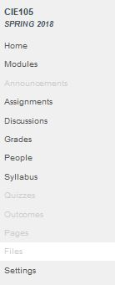
Canvas LMS Screenshot: Menus

Slide 19
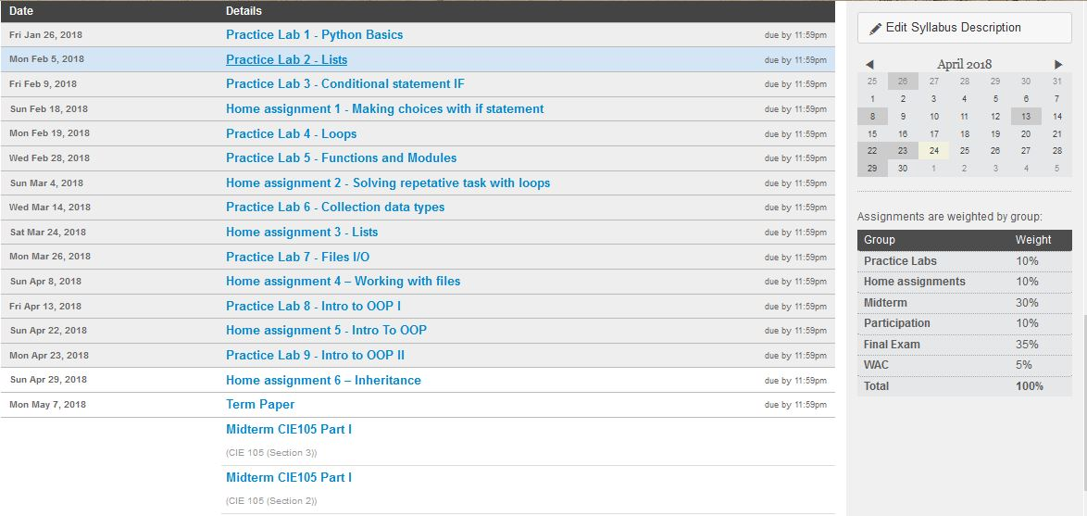
Canvas LMS Screenshot: Syllabus

Slide 20
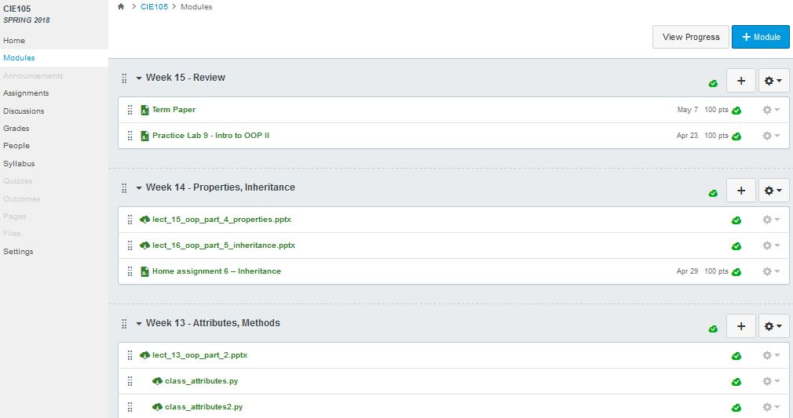
Canvas LMS Screenshot: Modules

Slide 21
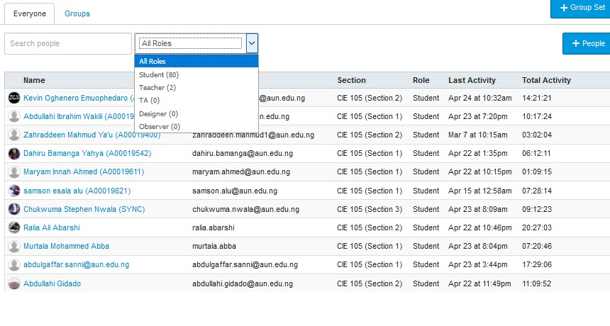
Canvas LMS Screenshot: People

Slide 22
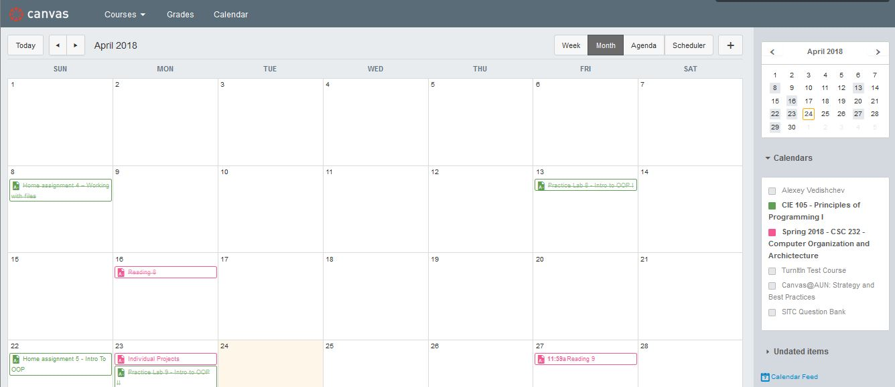
Canvas LMS Screenshot: Activities

Slide 23
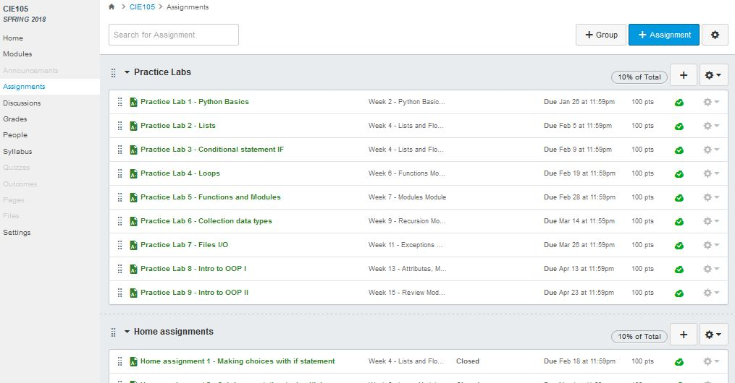
Canvas LMS Screenshot: Assignments

Slide 24

Canvas LMS Screenshot: User Info

Slide 25
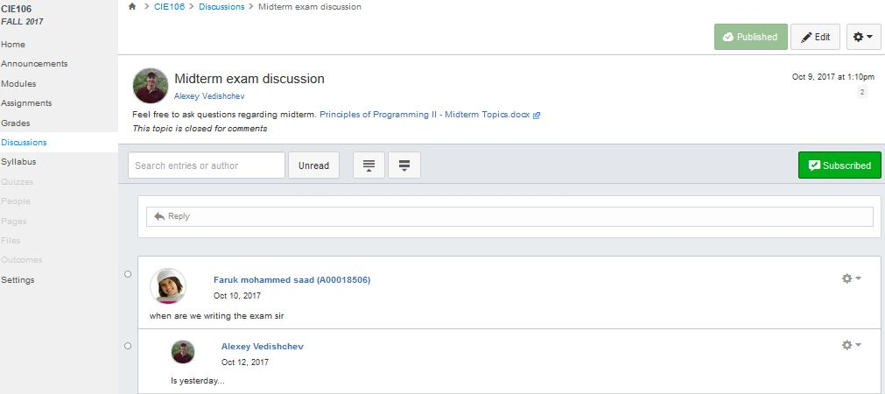
Canvas LMS Screenshot: Discussions

Slide 26
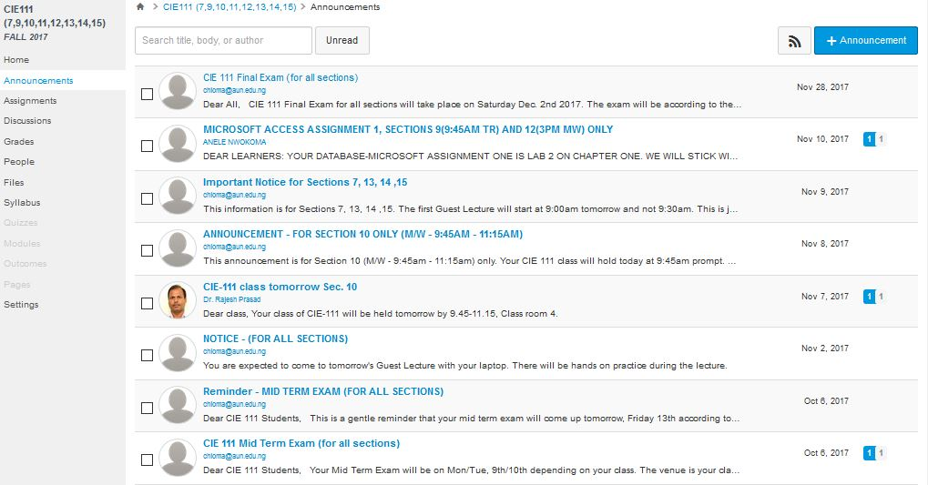
Canvas LMS Screenshot: Announcements

Slide 27
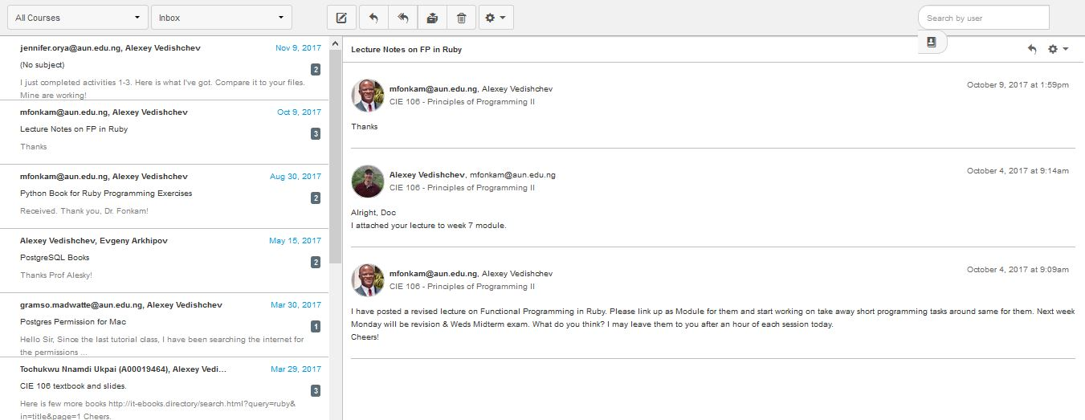
Canvas LMS Screenshot: Messaging

Slide 28
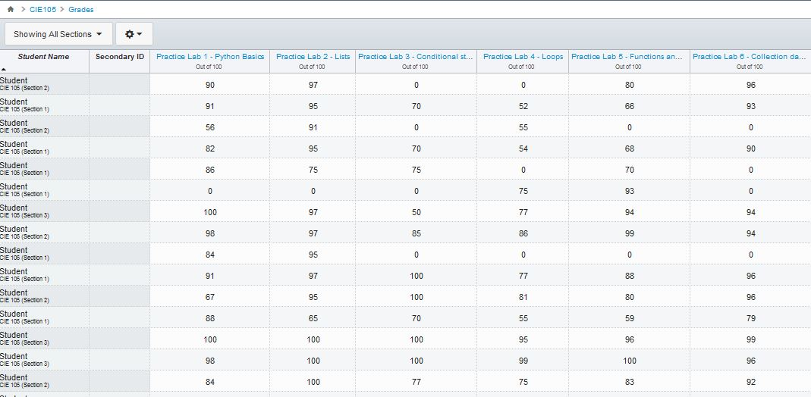
Canvas LMS Screenshot: Grading

Slide 29
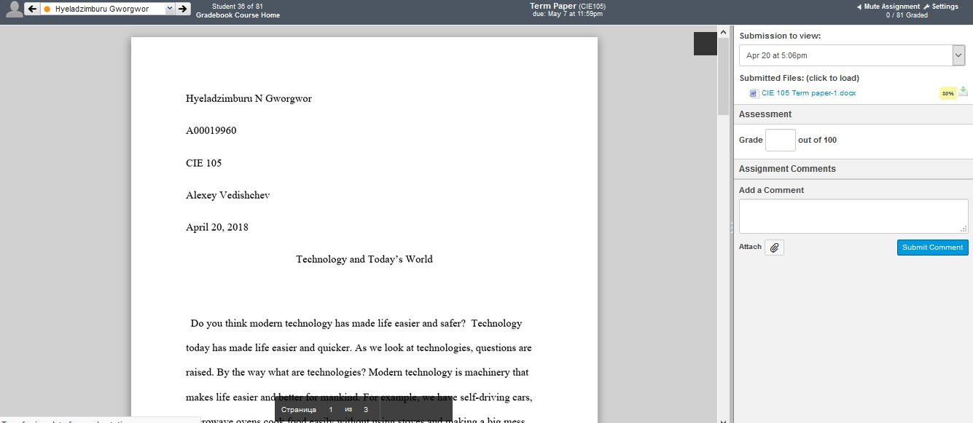
Canvas LMS Screenshot: Speed-Grader

Slide 30
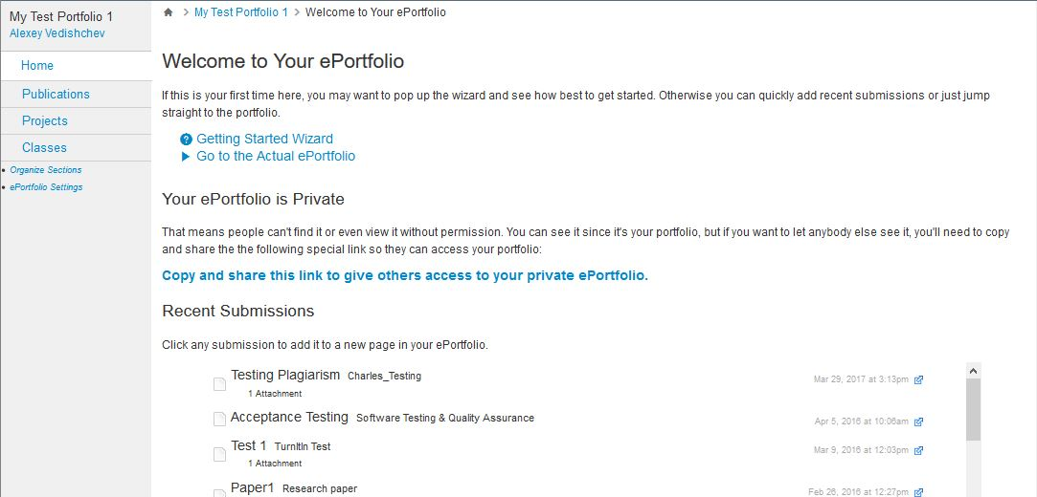
Canvas LMS Screenshot: e-Portfolio

