Slide 1
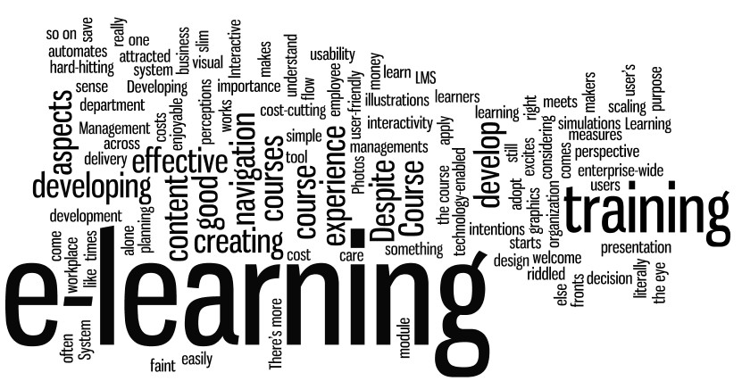
Analyzing Some Factors Hindering E-Learning Adoption in Developing Nations: Acceptability Perspective
PRESENTER:
Ibrahim ABDULLAHI PhD.
2018

Slide 2
PRESENTATION OUTLINE
1
Introduction & Motivation
2
Factors Affecting E-learning In Developing Countries
3
Motivation
4
Factors Affecting E-learning With Extended Relationships
5
Conclusion

Slide 3
INTRODUCTION
Electronic Learning (e-Learning) as widely called has been one of the most important form of knowledge actualization in the recent decades. The old conventional form of learning has been slightly reduced due to the high emergence of technological relationship enslaving the world. E-Learning is usually termed as the way, form and manner of knowledge acquiring and sharing using the Internet, devices and electronic installations.

Slide 4
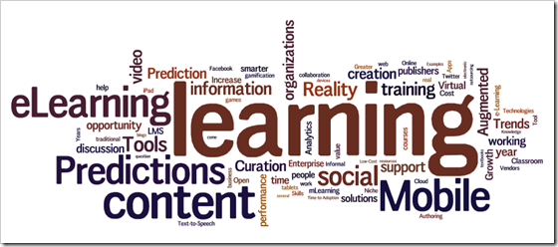
MOTIVATION
E-Learning are based on the application domain, learning methods, specialization and processes .
E-Learning as the means of learning that is enabled in a way ahead of the conventional board and chalk as electronically.
European Commission suggested that the use and reuse of multimedia driven approach and the Internet to increase the fundamental quality of accessing facilities, services in close or geo-locational distances is referred to as E-Learning.

Slide 5
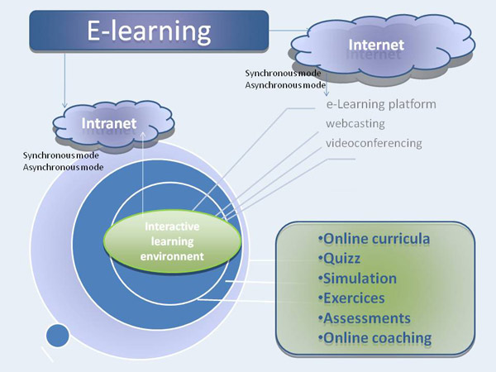
E-Learning OVERVIEW

Slide 6
FORMS OF E-LEARNING
Internet: Interconnected Networks of heterogeneous relationship and vast geographical difference
Intranet: A mid-close homogeneous interconnection of modules and category. Mainly in close geographical location
Asynchronous: E-mails, discussions, boards, web pages and blogs.
Synchronous: Video conferencing, instant messaging, chat, face2face meetings and social media

Slide 7
CHALLENGES AND RESEARCH ISSUES
Earlier in history, home education/home schooling has been the most fruitful form to the populace to meet the need of achieving a basic education but not open to ICT.
With the advent of the Internet, the need to migrate from the cultural direction became necessary.
However, due to some societal influence and control, young age groups are denied the flexibility of using the most common disposable form of E-Learning device (i.e. mobile phone).
In line with this condition, this study has seen the worthiness of accepting the Unified Theory of Acceptance and Use of Technology (UTAUT) as a bridging aid to curtail the societal disposition of the use of the technology among our students at all level.

Slide 8
COMPARISON OF E-LEARNING FORMS
Action | Asynchronous E-Learning | Synchronous E-Learning
When? | Reflecting on complex issues When synchronous meetings cannot be scheduled | Discussing less complex issues Getting acquainted Planning tasks
Why? | Students have more time to reflect due to expected answers that doesn't need immediate responses | Students are more serious and motivated. Quick response is needed
How? | Use means and forms such as e-mails, discussions, boards, web pages and blogs. | Video conferencing, instant messaging, chat, face2face meetings and social media
Examples | Topic discussion for blog maintaining, Student reviews and comments | The group is working among students. Online lectures and videoconferencing.
*
*
*
*

Slide 9
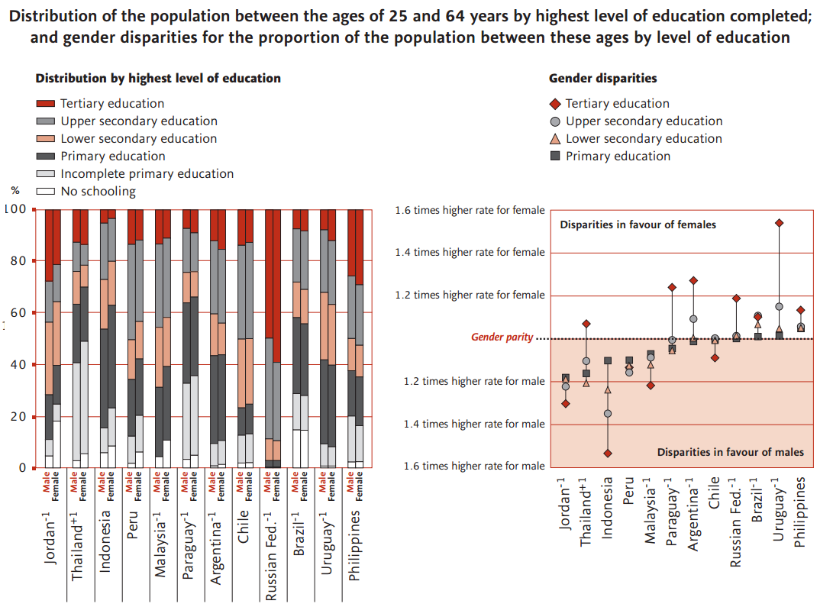
STATISTICS OF EDUCATION (E-LEARNING EFFECTS)
UNESCO Statistics; (Source: UNESCO Institute for Statistics, 2006)

Slide 10
FACTORS AFFECTING E-LEARNING
*
Lack of sufficient and better ICT deals in the Nigeria communities: Internet activities have received strong condemnation.A strong justification of believe is thus needed as a sanitization effect to juxtapose the yearned benefits of its help to the children in Nigeria.
The Gender sensitivity, especially among female pupils: Due to the conservative nature and shyness found in some cultural heritage, parents are strict in letting their daughters engage in ICT related activities.
Age: Barrier is the age brackets of who to use the ICT E-learning facilities.
Societal and cultural influence: In relation to the so-called western modernization, parents perceived E-learning and ICT as a societal - maneuver to influence their kids into ICT, E-learning addiction.
*
*
*

Slide 11
… FACTORS AFFECTING E-LEARNING
*
Family background and opportunities (income): It is thus seen advantageous to the children of the well-to-do parents. They benefit more on the E-learning and technology embracement.
Willingness and volunteer of using ICT for E-Learning: The natural willingness to use is low. Therefore, it is also a factor affecting the use of E-learning.
Availability and accessibility of the Internet and Computers: It is also presumed that if a product of resource is readily available, it could influence its usage and participation. POWER (Electricity)
Teacher characteristics: From the notion of train the trainer, a teacher who does not go through the use of E-learning and ICT related education, cannot transfer the knowledge.
The role of design and contents of the E-Learning materials: Misplacement of the coursework as it relates to the level of students' class could negatively influence the benefits of E-learning.
Intention of use of E-learning: Very important variable is the intention to use the ICT.
*
*
*
*
*

Slide 12
FACTORS AFFECTING E-LEARNING WITH EXTENDED RELATIONSHIPS
Lack of ICT Awareness
(Fund, Location and Orientation)
Availability and Accessibility
(Proximity, Government Policies)
Gender Sensitivity
(History, Islamic heritage)
Design
(Programmers and Modules)
Age
(Folks, Peer and Sex)
Teacher
(Training)
Societal and Cultural Influence(Alamri, Cristea, & Al-Zaidi, 2014)
(Location, Tribe)
Willingness to the Use of ICT(Alamri et al., 2014)
(Intention, self efficacy)
Family
(Income, resources)
Intention
(Willing)

Slide 13
CONCLUSION
Presented are the problems associated to the lack of adapting E-Learning in the primary schools and general schools include, administrative challenges, cultural institution.
Lack of facilities and maintenance culture, technological incapability of handling the software's and hardwares, ethical challenges such as socio-cultural declination, political affiliation, societal perception and negative judgments about the Internet, willingness of the teachers, inferiority between the teachers among others.
The need to research on the effects and devising models that would mitigate the fears and improve the willingness of the people of Nigeria to allow the inculcation of the e-leaning to their wards is of enormous benefit.

Slide 14
Appreciation
THANK YOU FOR LISTENING

